Slide 1
Machine Learning and Its Applications

Slide 2
Introduction
Field of study that gives computers the ability to learn without being explicitly programmed – Arthur Samuel (1959)
Arthur Samuel – Checkers Playing Program
A Computer Program is said to learn from experience E wrt task T, Performance Measure (P) – if its Performance on T – Measured by P – increases with experience E.

Slide 3
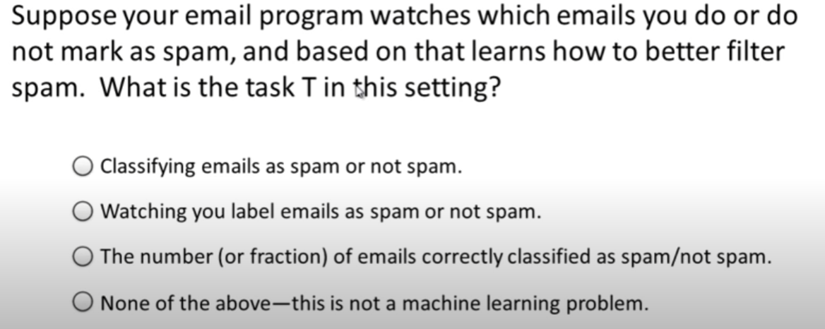
Introduction

Slide 4
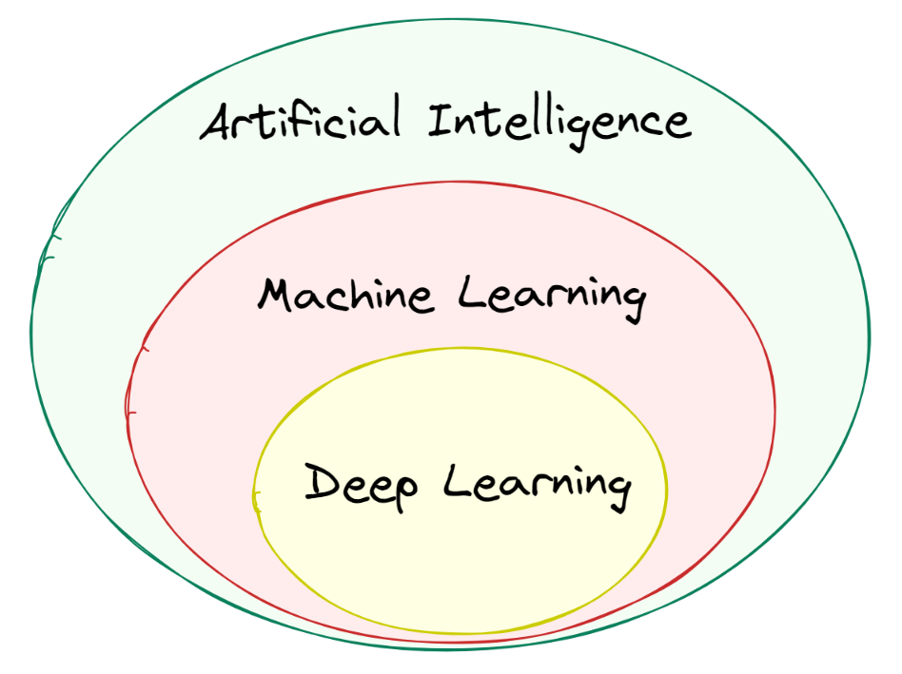
AI vs ML

Slide 5
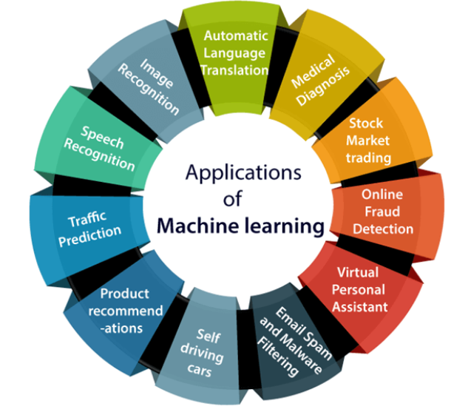
Applications of Machine Learning

Slide 6
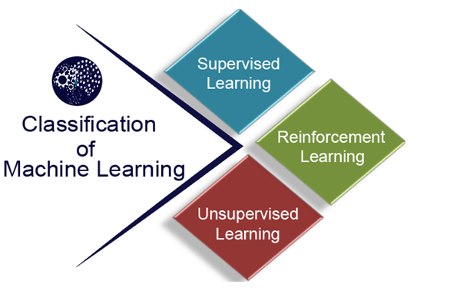
Types of Machine Learning Algorithm
Supervised Learning
Unsupervised Learning
Reinforcement Learning

Slide 7
Supervised Learning
Supervised learning - training set to teach models.
This training dataset - inputs and correct outputs.
Accuracy measure - loss function, error -sufficiently minimized.

Slide 8
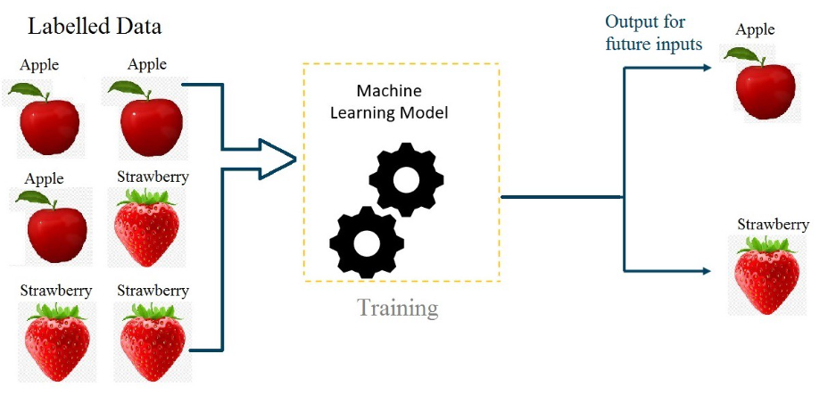
Supervised Learning

Slide 9
Supervised Learning Algorithms
Linear Regression (Regression – Continuous Data)
Logistic Regression (Classification – Categorical Data)
Support Vector Machine (Classification)
K-Nearest Neighbour (Classification)
Random Forest (Both)
Neural Networks (Classification)
Logistic Regression (Binary Classification)
Naïve Bayes (Classification)
Decision Tree (Classification)

Slide 10
Supervised Learning - Examples
Image and Object Recognition
Predictive Analytics
Customer Sentiment Analysis
Spam Detection

Slide 11
Unsupervised Learning
machine learning algorithms - analyze and cluster unlabeled datasets.
Discover hidden patterns or data groupings without the need for human intervention.
Ability to discover similarities and differences in information.

Slide 12
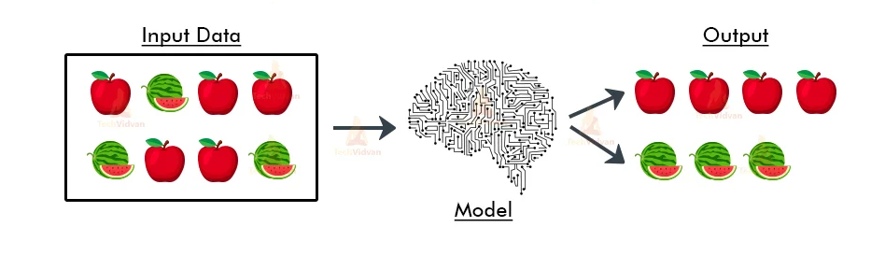
Unsupervised Learning

Slide 13
Common unsupervised learning approaches
Clustering
Association Rules
Dimensionality Reduction.

Slide 14
Applications of unsupervised learning
News Section
Anomaly Detection
Customer Persona
Recommendation Engine

Slide 15
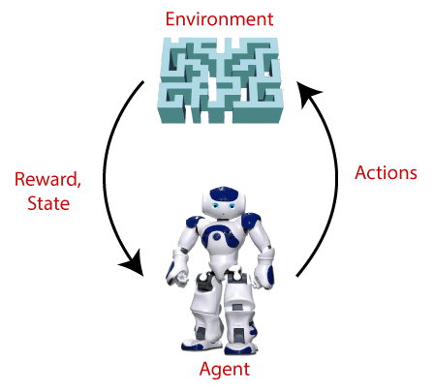
Reinforcement Learning
Reinforcement learning (RL) - how intelligent agents ought to take actions in an environment - to maximize the notion of cumulative reward.

Slide 16
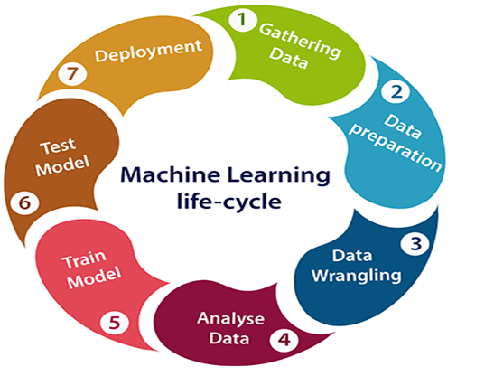
Machine Learning Life Cycle

Slide 17
Machine Learning Life Cycle
Gathering Data – Data Source – Collect – Integrate
Data Preparation – Data Exploration – Understand – study
Data Wrangling – Cleaning – Raw Data – Usable – Missing – Dup – Invalid
Data Analysis – selection of Algo – Build Model.
Train the Model
Test the Model
Deployment

Slide 18

Data Sets
A dataset is a collection of data in which data is arranged in some order. A dataset can contain any type of data.
Numerical data: Such as house price, temperature, etc.
Categorical data: Such as Yes/No, True/False, Blue/green, etc.
Ordinal data: categorical, statistical data type where the variables have natural, ordered categories

Slide 19
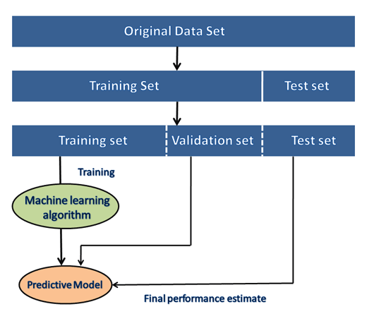
Data Sets

Slide 20
Data Sources
https://www.kaggle.com/datasets
https://archive.ics.uci.edu/ml/index.php
https://registry.opendata.aws/
https://datasetsearch.research.google.com/
https://msropendata.com/
https://github.com/awesomedata/awesome-public-datasets
https://visualdata.io/discovery
https://data.gov.in/
https://data.gov/
https://www.opendatani.gov.uk/
https://data.europa.eu/en

Slide 21
Metrics - Classification
Accuracy,
Precision,
Recall, and
F1 Score,

Slide 22
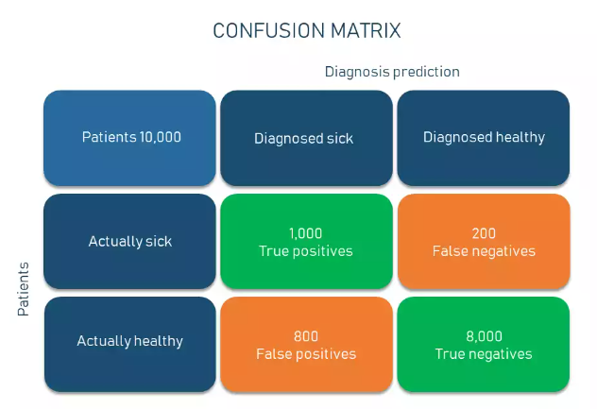
Confusion Matrix

Slide 23
Confusion Matrix
True Positive (TP) — a class is predicted true and is true in reality (patients that are sick and diagnosed sick)
True Negative (TN) — a class is predicted false and is false in reality (patients that are healthy and diagnosed healthy)
False Positive (FP) — a class is predicted true but is false in reality (patients that are healthy but diagnosed sick); and
False Negative (FN) — a class is predicted false but is true in reality (patients that are sick but diagnosed healthy).

Slide 24
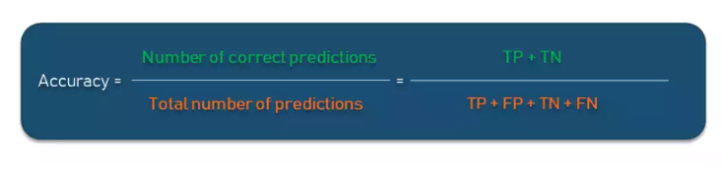
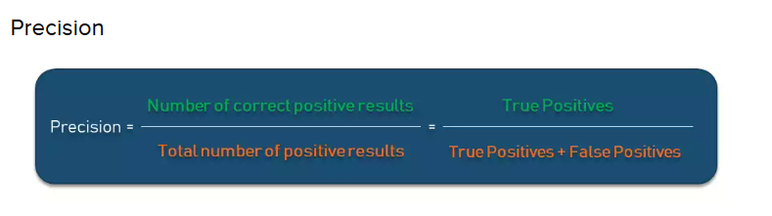
Accuracy and Precision
Accuracy is used to calculate the proportion of the total number of predictions that were correct.
Precision shows what proportion out of all positive predictions was correct

Slide 25
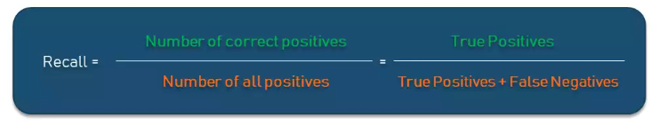
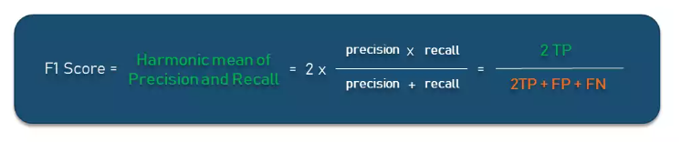
Recall and F1 Score
Recall shows a proportion of correct positive predictions out of all positives a model could have made.

Slide 26
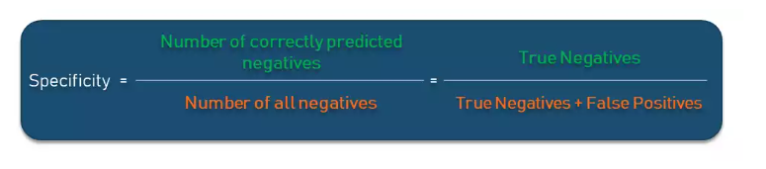
Specificity
Specificity is the proportion of actual negatives that the model has correctly identified as such out of all negatives.

Slide 27
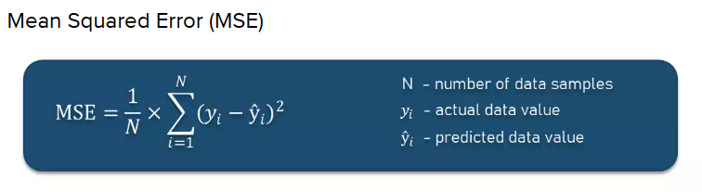
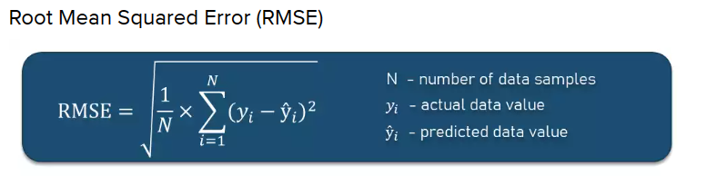
Performance metrics for regression problems

Slide 28
Queries….

